Slide 1


Slide 2
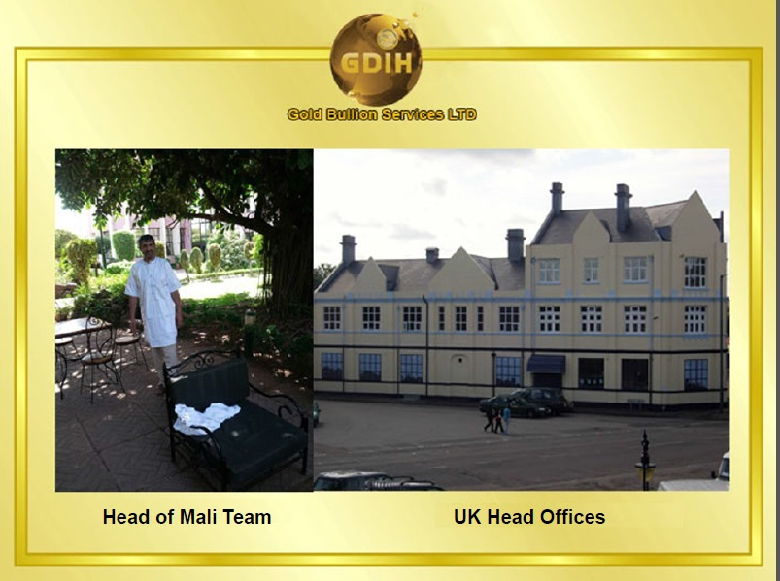
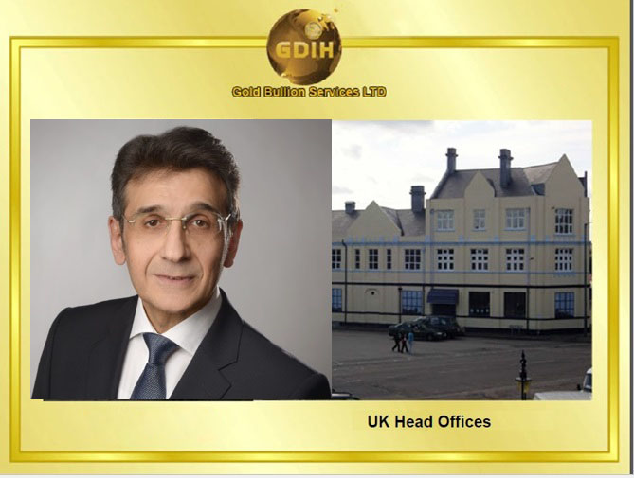

ARTO KAZANDJIAN
Head Of Business Development for Asia and Africa

Slide 3
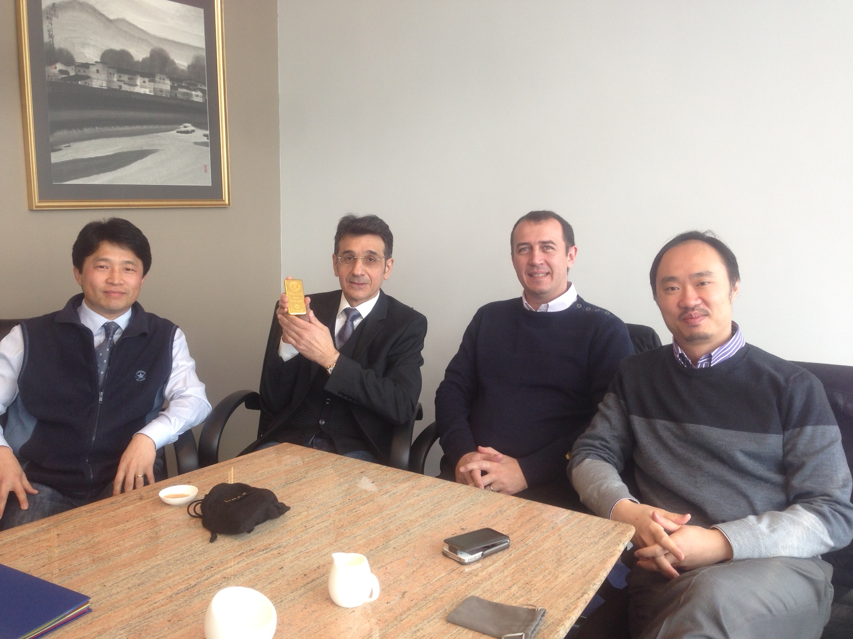

Slide 4


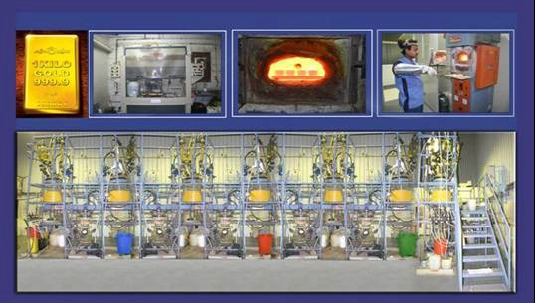
Saudi Gold Refinery Company
Mali and Ghana Team of GDIH Bullion to supply additional gold and diamonds to Suliman Saleh Al Othaim Group

Slide 5

FINANCE | REAL ESTATE | TRADING | OIL & GAS | MEDIA & | TRANSPORT
Insurance | Rotating Tower | Gold | Petrochemicals | ENTERTAINMENT | Cars
Sale-Lease Back | Hotels & | Diamonds | Crude Oil | Advertising | Yachts
 | Hospitality | Precious Metals |  | Events | Air
 | Theme Parks | Cement & Aggregate |  | Studio Night Clubs | Water Transport
www.gdihworldwide.com
Film Production

Slide 6
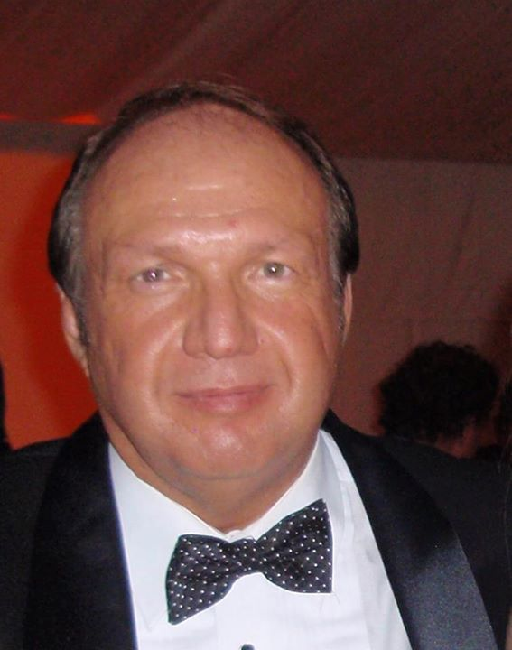

DIRECTOR OF BUSINESS DEVELOPMENT & GOVERNMENT AFFAIRS
CHAIRMAN OF THE BOARD

Slide 7


CERTIFICATE OF INCORPORATION OFA
PRIVATE LIMITED COMPANY
Company Number. 8430330
The Registrar of Companies for England and Wales ,hereby certifies that GOTH GOLD BULLIO SERVICES LIMITED
is this day incorporated under t he Companies Act 2006 as a private company, that the company is limited by shares, and the ituation of its registered officeis in Jingland and Wales.
Given at Companies House,Cardiff. on 5th March 2013 .
((f)
OFc0..,
.,, ··......... ·-
o( No "9
THE OFfJCIAL SEAL. Of THE
REGISTRAR OFCOMPANIES
Companies House
-for thertCOf'd -
The above in!onnation was conuuunicaled by electronic means and auOienticated by the
RegislJ':lr of Companies unrler section 1115 of lhe C'ompanies Act 2006

Slide 8
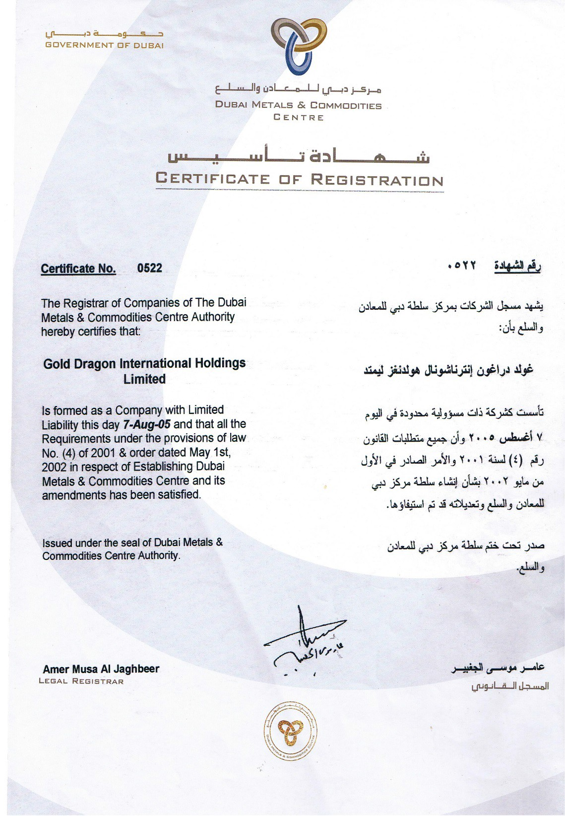

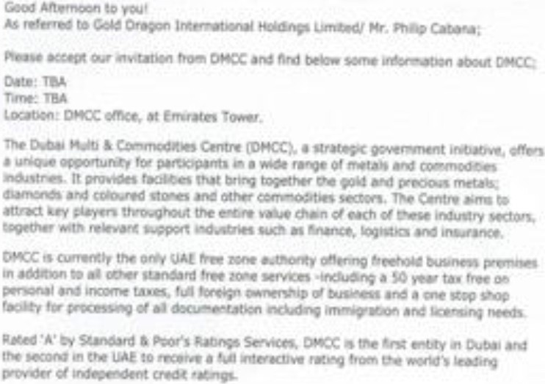
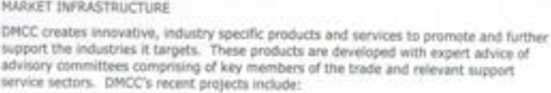
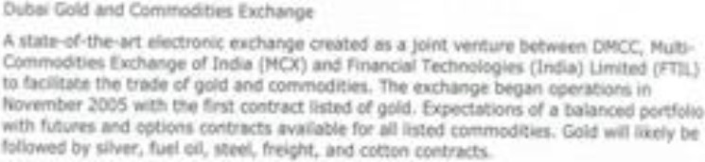
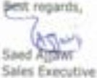

• - .
•
• •

Slide 9






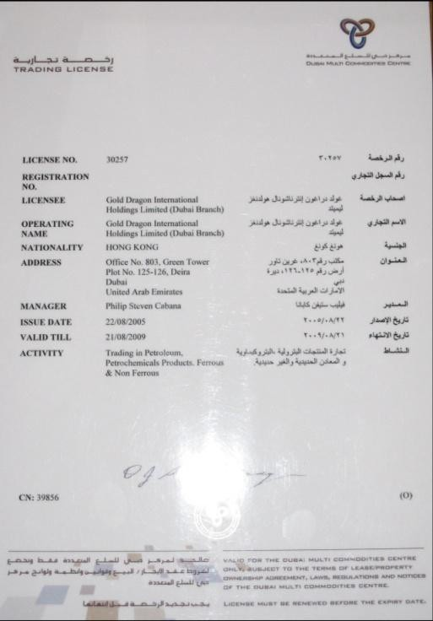













The UAE is proudly the first Arab country to implement KPCS. The facilitation of trade of rough and polished diamonds through the Dubai Diamond Exchange, has provided major impetus to the diamond industry in Dubai and the region.
The Centre accommodates every facet of the business - manufacturing, trade, education, certification and technology. Alliances with other players in the trade such as financial organizations, government institutions, etc, and promotes complete growth of the industry.
Housed in the purpose-built landmark Almas Tower (Almas means „diamond‟in Arabic), Dubai‟s diamond community is set to sparkle more brightly than ever.
Strategic Relationships with GDIH GAT – www.goldenarrowtrading.com DMCC – www.dmcc.ae
DFX - www.nasdaqdubai.com
SOG – www.joj.com.sa

Slide 10


Throughout history Dubai has played a significant role in the global gold market and is now a bullion centre of international significance. Popularly known as the “City of Gold‟, Dubai is ideally located amidst a large consumer market, and uniquely positioned to channel gold from the international market to its ultimate destination.
The Dubai Multi Commodities Centre has integrated the refining, manufacturing and trading of gold and plans to introduce the trading of other precious metals such as platinum, palladium and silver. DMCC has facilitated the development and expansion of the local and regional precious metals market.
The Centre is contentiously working with partners both regionally and internationally to promote the highest global standards in product and service development, while simultaneously encouraging greater transparency to the benefit of all market participants.
Strategic Relationships
WGC – www.gold.org
The Bullion Room
Cambridge Bullion Ltd.
Capela Metals England
Saudi Gold Refinery Company
Metalor Switzerland
Gulf Gold Refinery Dubai
NTR Metals Amsterdam
Baird & Company UK

Slide 11


Good London Delivery (GLD) Accredited smelter and assayer members of the London bullion market whose gold and silver bars are accepted without question in settlement against transactions conducted between
each other and with other acceptable counterparts are provided with the Good London
Delivery status. (GLD).
The LBMA Good Delivery List is recognised as the de facto standard for the quality of gold and silver bar criteria for assaying standards and bar quality that an applicant must satisfy in order to be listed. The assaying capabilities of refiners on the Good Delivery List are periodically checked under the LBMA's Proactive Monitoring programme.

Slide 12


GDIH Joint Venture with China Gold
China Gold International Resources Corp. Ltd. (TSX:CGG – HKEx:2099) is a Canadian based, profitable and growing gold and copper producer. The company operates two producing mines in China: the CSH Gold Mine in Inner Mongolia Region, and the Jiama Copper-Polymetallic Mine in Tibet Region. CGG is the flagship and the only overseas listing vehicle of the largest gold producer in China and 39% shareholder, China National Gold (CNG).
http://www.chinagoldintl.com/

Slide 13
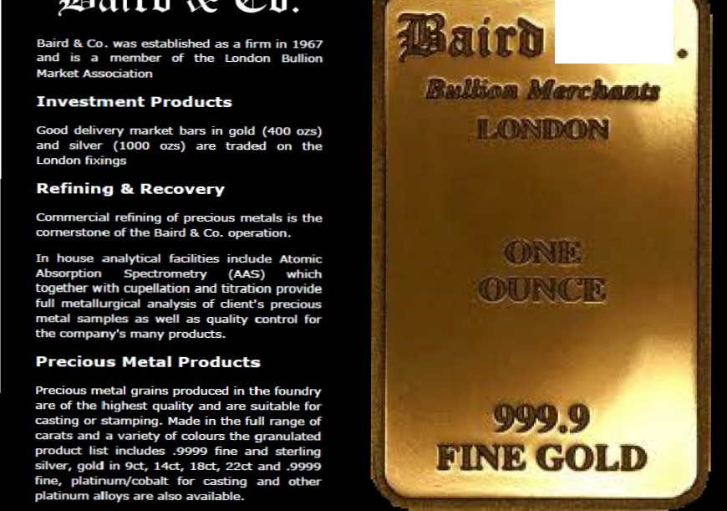
&Co

Slide 14


About The Bullion Room
Welcome to The Bullion Room, dealers in precious metals with headquarters in Birmingham's Jewellery Quarter and a branch in Manchester. Specialist processors and recyclers of scrap metal from trade sources and dealers of Investment Products, The Bullion Room's clients are both independent jewellers and large pawn brokering chains, investors and international institutions. The Bullion Room strives to ensure that all of our clients, large or small, benefit from our excellent business and payment terms, and experience our high levels of personal service.

Slide 15

Cambridge Bullion

Slide 16



Slide 17


Slide 18
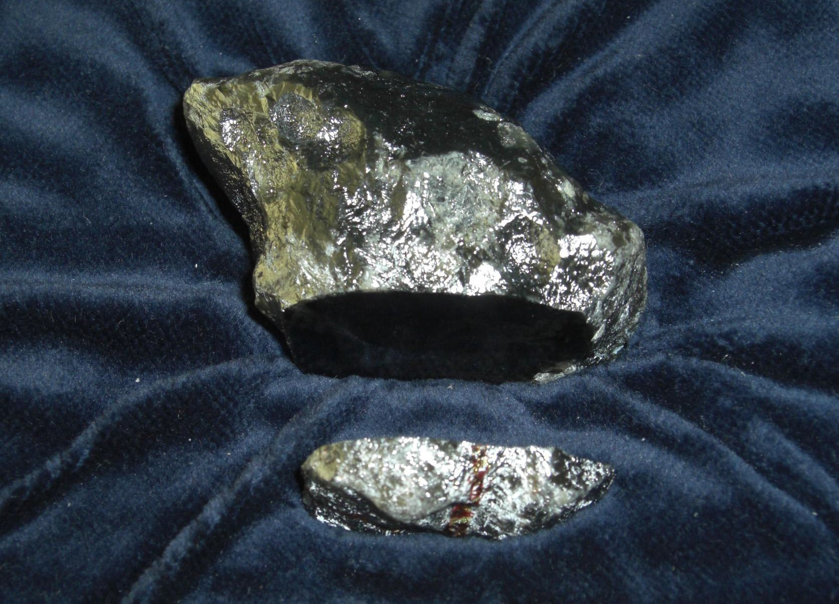



GDIH Joint Venture with HITC and Asanteman Development Council represented by His Majesty, Otumfuo Osei Tutu II, Asantehene and King of the Asante Kingdom of Ghana
Infrastructure development for gold concessions and mining operations for gold and diamonds with SC Corp.

Slide 19
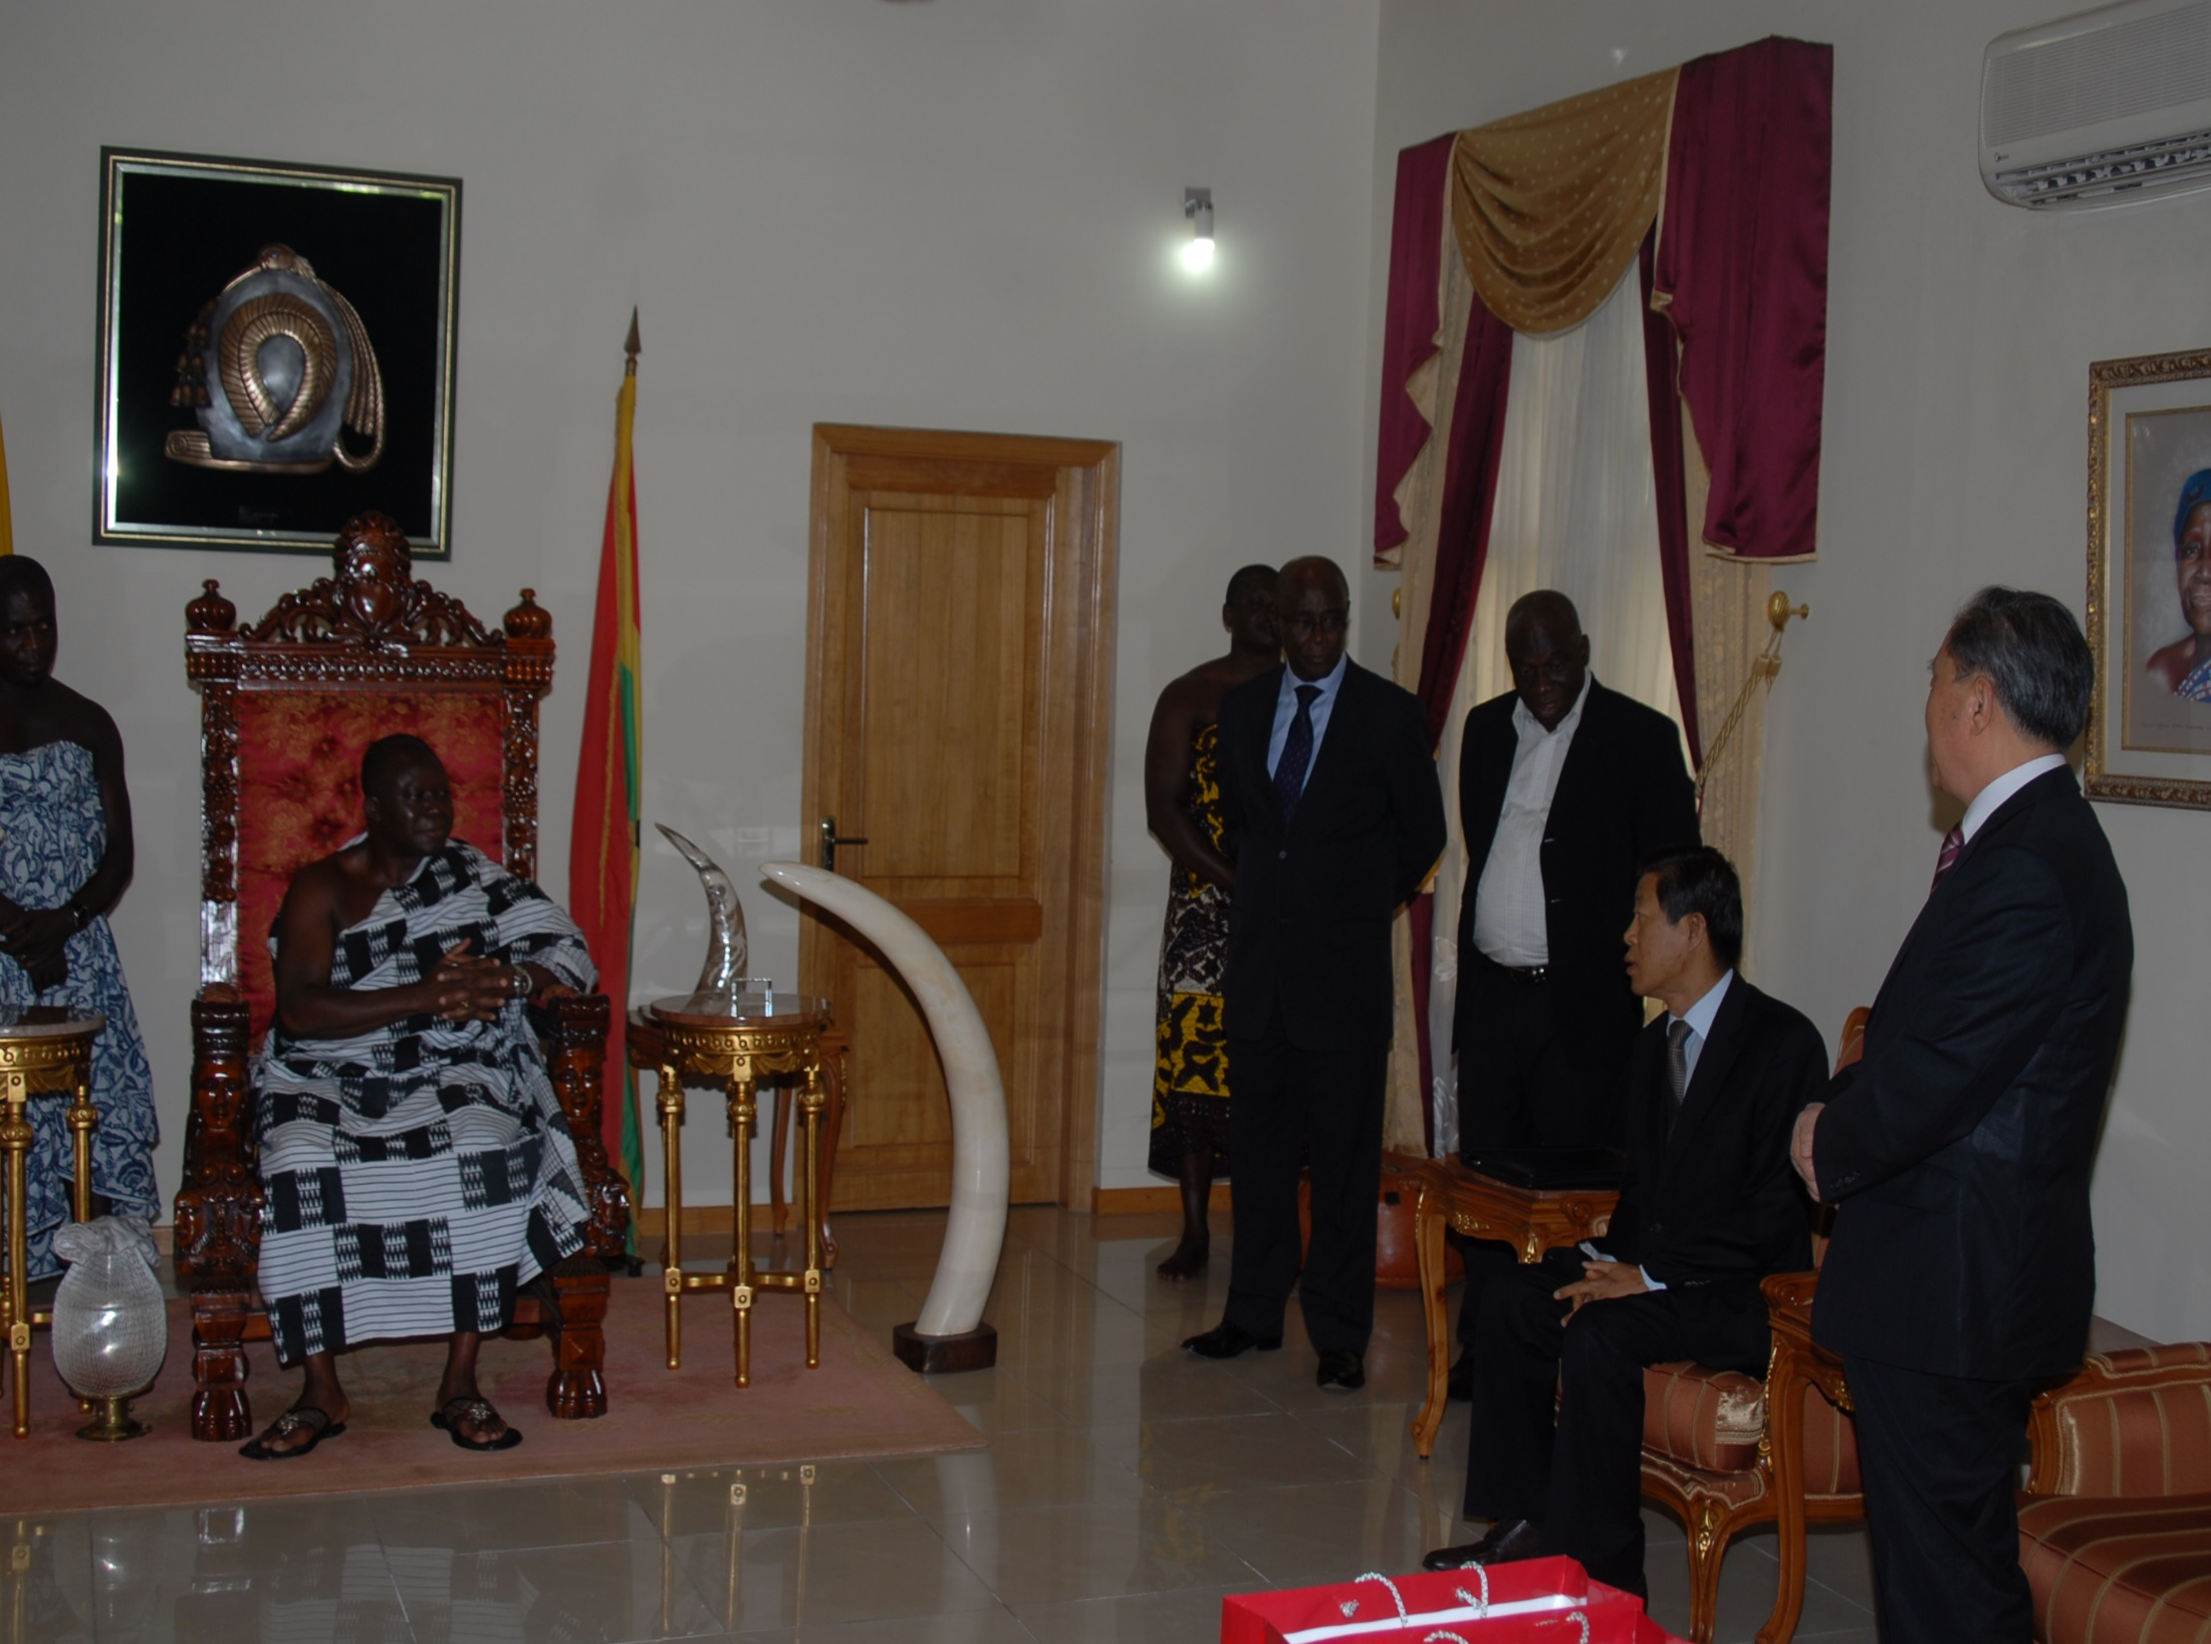

Ashanti Kind Tutu II Signing Ceremony

Slide 20
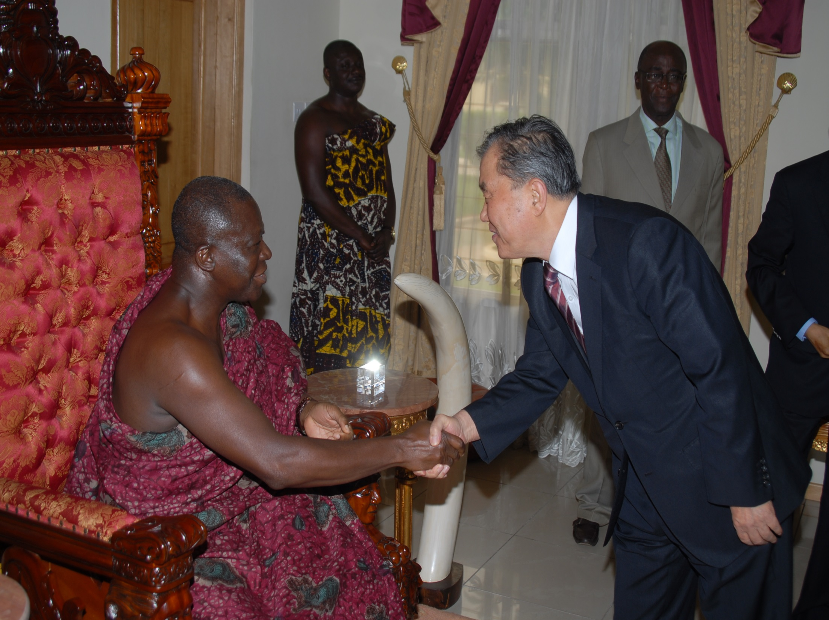

Slide 21


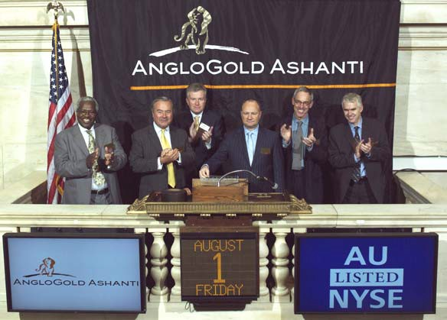
GDIH Bullion Investment Ltd. Is in discussion for Joint Venture with Anglo Gold Ashanti in both Mali and Ghana on bringing additional capital for expansion of concessions and refineries to through
the Joint Venture international sales of
to increase the new and
existing mining operations.

Slide 22
Ashanti Gold Project
Key Facts
GDIH Gold Bullion Investment Ltd and GDIH bring their refineries and marketing teams to support sale and transport of gold for increasing output of both existing mining operations and concession expansion to increase gold production for the further expansion of infrastructure related developments for His Majesties project and supporting SC Corp on bringing renewable energy technologies and Pharma business to the consortium.
  GDIH Gold Bullion Investment Ltd and GDIH will support SC Corp on the existing sales of 1,000 Kgs of Gold dore at a 20% discount off LBMA pricing delivered to our consortium of refineries
  GDIH will assist SC Corp in equipment procurement and investment secured by gold production for the development of 80+ new Mining Concessions.
The required equity for project finance will be generated by leveraging the 20% discount with a major U.S. Brokerage House. The resulting financial facility will provide the liquidity to directly fund the Royal Mall and the Majestic Royal Homes projects.
Another advantage provided is that the Consortium has the right to export without PMCC and also has direct access to Ashanti Gold company supplies for additional quantities and direct relationships with the Chieftains and full security support of the Ashanti for the export and licensing of future mining operations which complete feasibility studies have been completed for projects like Yellow Gold and other developments listed on the map in this presentation.

Slide 23


Panning for Ashanti Gold both Ghana And Mali

Slide 24


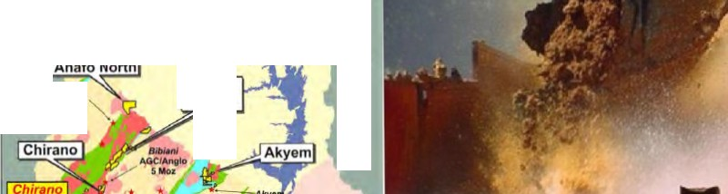

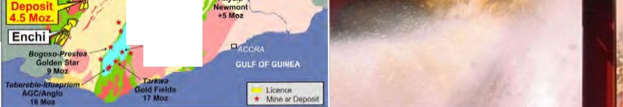
PROPERTY LOCATIONS MAJOR GOLD DEPOSITS GHANA
GHANA
Vo/la Basin
COTE O'IVOIRE
-
TOGO
.......m..<.H.'lt
Blbiani North
•
4--- 0bu•sl
•
AGC/Aoglo
41 M
Damang Oo•d Flelda S Moz

Slide 25

Payment Structure
Seller sends FCO
Buyer signs and returns FCO
Seller sends SPA
Buyer signs and returns SPA
Buyer / Seller arrange flight for visit / inspection of local mining or office in Bamako
Seller / Buyer visit GNDM (National Assay Office) to get assay report before Shipment, after assay buyer has two payments methods.
  Either Gold is transferred to Government Approved Transit Company with payment made in full OR
  Buyer pays 7%-8% of assay value and Sellers Representative accompanies the gold to witness final refinery and quantity at buyer refinery before final payment by buyer.
  Buyer refinery will allow Seller Rep to enter to witness assay at buyer destination.
  If second option is selected, Buyer to pay for Seller’s Representatives hotel, meals at buyer’s refinery destination. Buyer to pay Seller by TT within 72 hours of assay at buyers refinery.

Slide 26
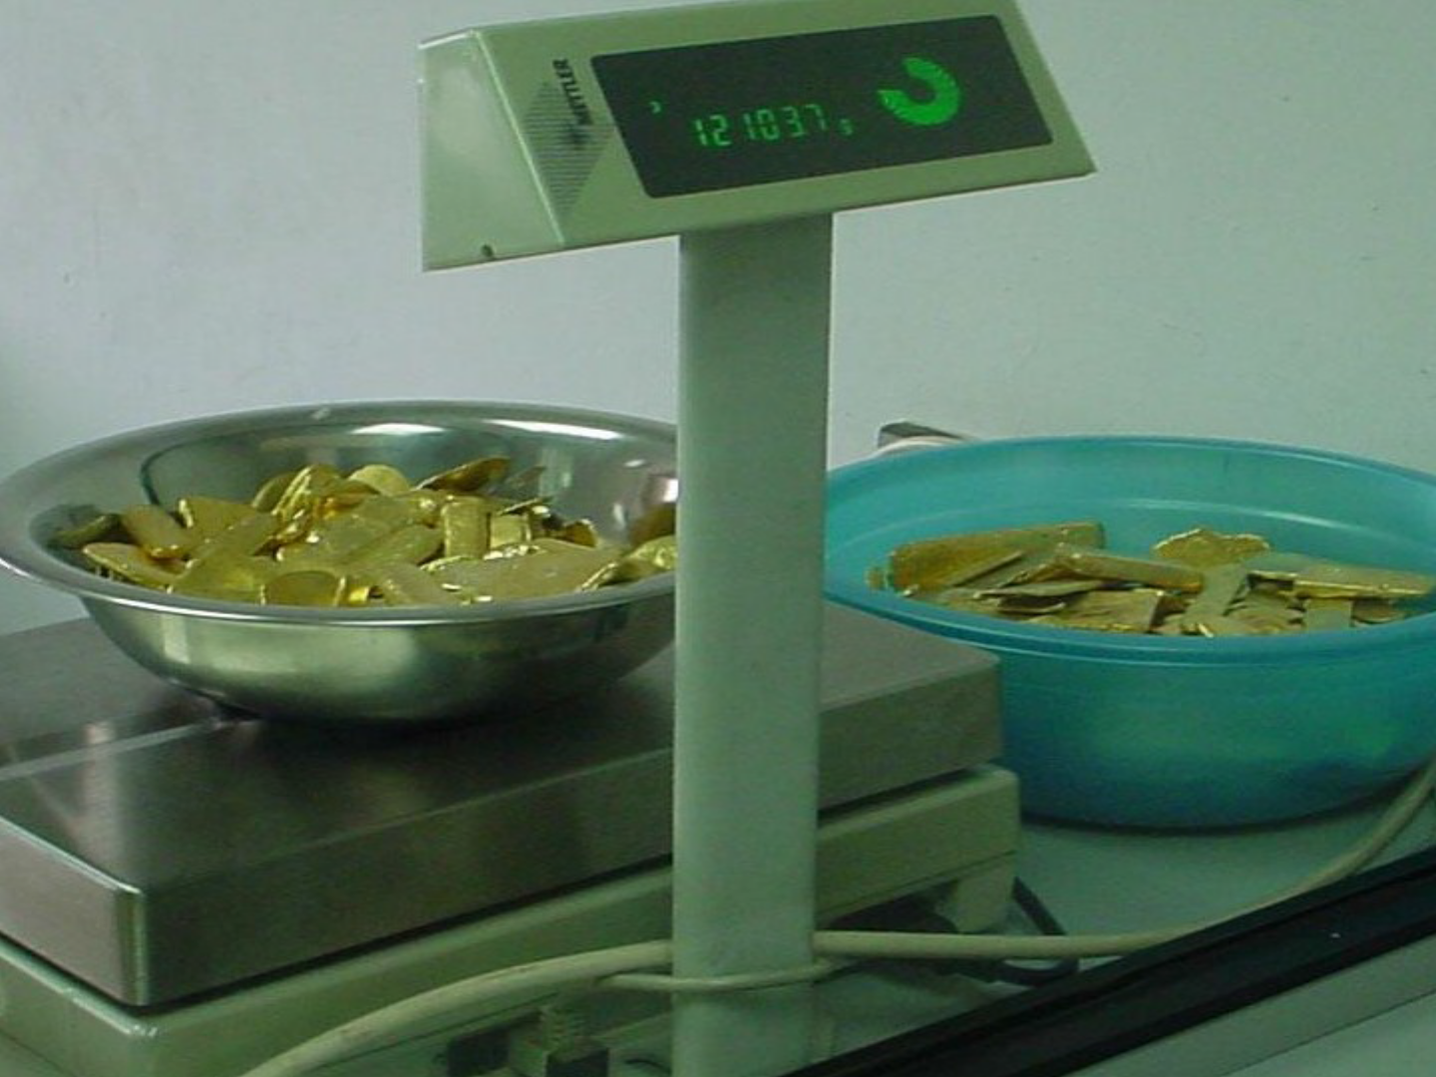

Slide 27


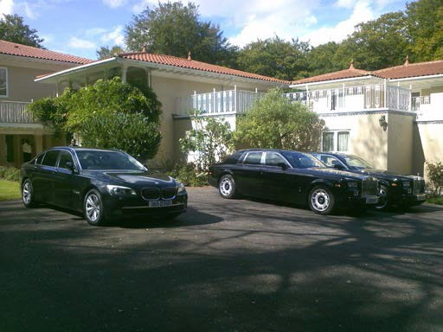
"the only limits we have are those we impose on ourselves."

Slide 28

Joint Venture with GDIH Bullion Joint Venture with Kembel AG in Switzerland and Lichtenstein

Slide 29
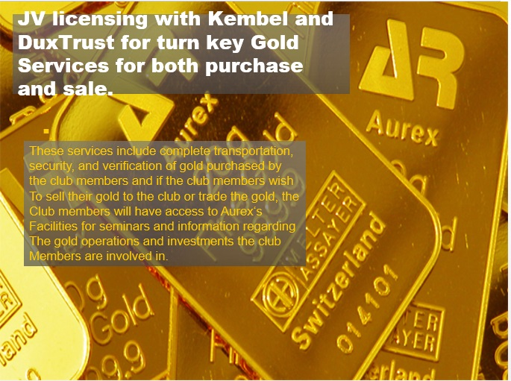

Slide 30



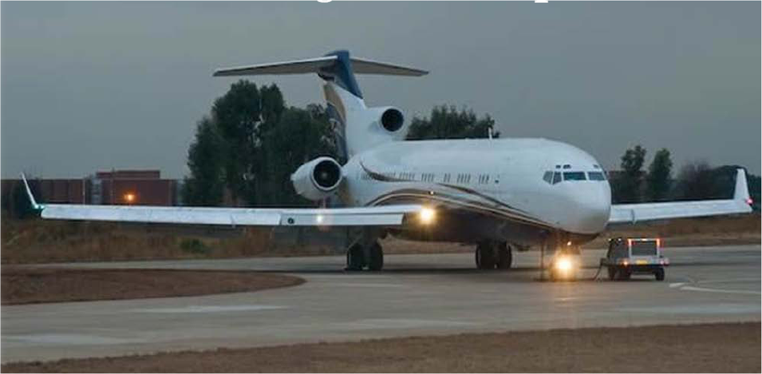
Gold Investment Opportunities
Joint-Venture with Aerospace company to supply gold bullion to club
members through our gold and diamond platform and sales to banks
and security houses which are part of the club‘s investment network.
There will be a discount to club members off of the London second closing price based on the volume of bullion they wish to purchase. Accounts are available at Kantonalbank, Julius Bär, and XCell for deposit of the product. All product will be certified and hallmarked for club members‘ inspection.
The club members also have access to
private jet service the club supplies for
transport of commodities and club
members in luxury.

Slide 31
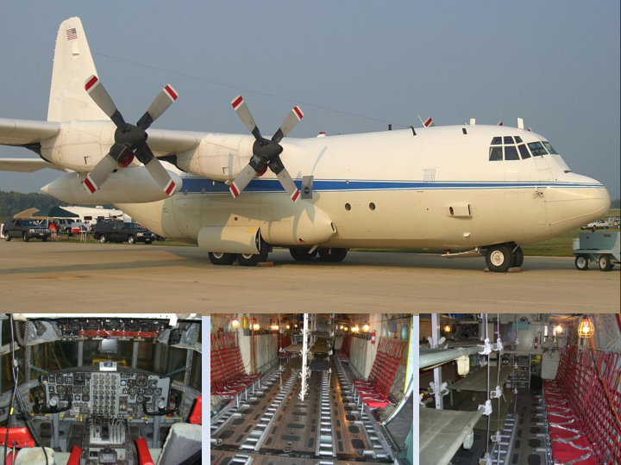

Slide 32

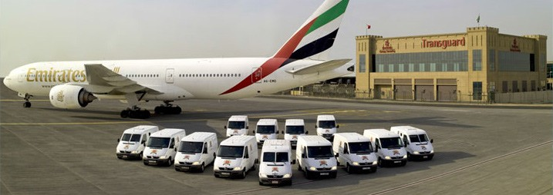


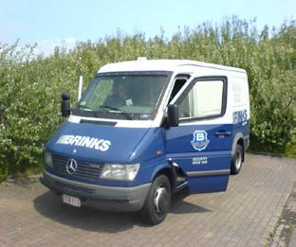
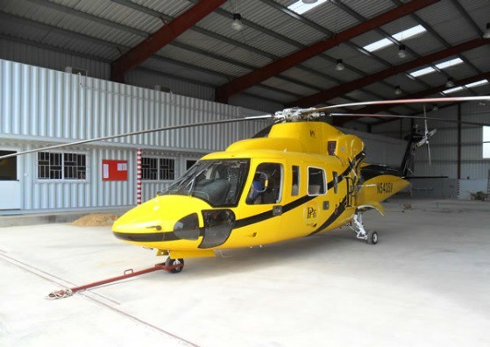
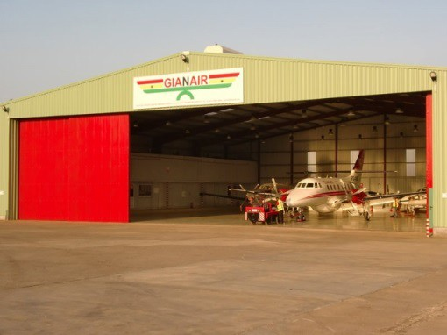

GDIH Bullion Investment Ltd is currently completing an agreement between Transguard, Brinks and Gulf Gold Refinery DMCC to secure additional supply line security from both Mali and Ghana to Dubai using existing flights through Air Maroc and Ethiopian Airlines as the primary insured carriers of African gold and precious metals. GDIH will engage additional private charter aircraft to the free zone in Dubai for security and transport purposes of the gold to the final refining locations for certification of Assay and payment. In Ghana we are using Gianair for local transport to international hub terminals via by both helicopter and plane.

Slide 33

















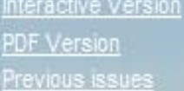
I!llBRINKS
Worldwld0 Corporate Site ®'
I ABOUT BRINK'S I
CAREERS I CONTACT us I
PRODUCTS & SERVICES
(.11")0!;.f'! l1 (.OUOii)'
Brink's Aviation Security announces the official launch of their new Web site.
The Brink's Journal is an on-fine news magazine that brings current industry information and knowledge to customers andemployees.

Slide 34
sa
Valcambisa
AboutUs I
Our Products I
Document Library I
Useful Links
WhyValcambi?
Home> ...bout Us>WhyValcamb1?
Intoday'sfiera!ly competitive and fast-changing busin1menvironment 'lli'e are constantly reviewing our services in the light of feedbaci:from our clients.
When considering a precious metalsrefining parlna there are manyfadoo to !hint about. We believe that Valcambi delivers a paci:age of JJfoduds and servicesthat are second-to-none.
Compared to the high intrinsicvalueof the metals that we processon our clients'behalf, the adual cosiof our value added servicesare small when compared to:
CountryandPolitical Risk
Our plant islocated in Switzerland , offaing the seClJlityof extremely low countryri: l ooupledwith political stability anda sound economy. It isfor good reason that Switzerland remainsthe homefor ova 50%of global savings.
"Totake any country orpolitical risk is
not a logical risk return cl@Cision"
Quality andService
Wego to great lengths to ensure the sustained quality of our produds. Wedeliver on our promises. Valcambi'slaboratory was the firstto beacaedited bythe SwissGovanment for assay, trading and meltingof pl'ecious metals. Our facilitiesare audited by the SwissFederal Offill!of Metrology andAcaeditation under ISO/IEC 17025standard;. The whole operation isISO9001 compliant.
ABR ECHNUNG Abrechnung Nr. I Datum 2762473 2007 I 13.11.200 Tresor Raffinerien Ansprechpartner I Telefon Sig.na Darla Cereghetti I 09 lhre Kundennummer bei uns 12845
 | 7 1 I 695 53 11
AUREX MANAGEMENT & INVESTMENT AG
Ahornweg 7
5504 Othmarsingen
6
l/Sendung am 08.11.07 eingetroffren
Goldbars, kg 15,000 1O
Nr.der Barre
Metall
Gewicht nach der Schmelzung g
Feingehalt o/oo
Gewicht g
Feingewlcht g
VCH 1256.00
Total
Au
Au
14.992.40
14.992.40
919,8000
13.790,01
 | 13.790,01 | 13.790,01
72,0000 | 1.079.45
 | 1.079.45 | 1,079,00
VCH
1256.00 Ag
Total Ag
14.992,40
14.992,40
Feingowicht g
%
Feingewicht g
Au | 13.790,01 | 99,800
Ag | 1,079,00 | 98,000
Au in oz
13.762.43
1.057,00
Feingewicht oz
442,472
33,983
Ag in oz

Slide 35
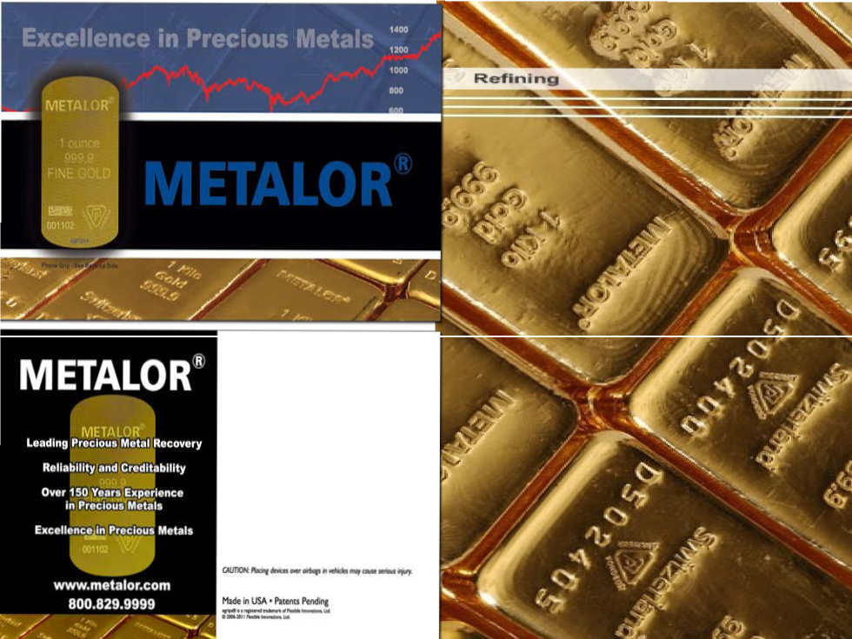
P,_,,a Devk•• From SUdlns on Atty Surface! TheWorid Ho>tAdv1nced N on·Sllp Material Ultra TNn • Lona Lat.tins • Cltanly aw.Mhnl'W9
NOT STICKY ...STAYS CLEAN
egrfp.s·QIJiiiNJOI'
noD<Slip strips'
......
1_{t}.C_...,....,.........".''4"ce l.l.d..l.w.l..,...............,,.,.,...
.t.a_s..,.,...,.d..w..m..t.!.c.t.!¥..t..,..,...............,U'lk&.

Slide 36
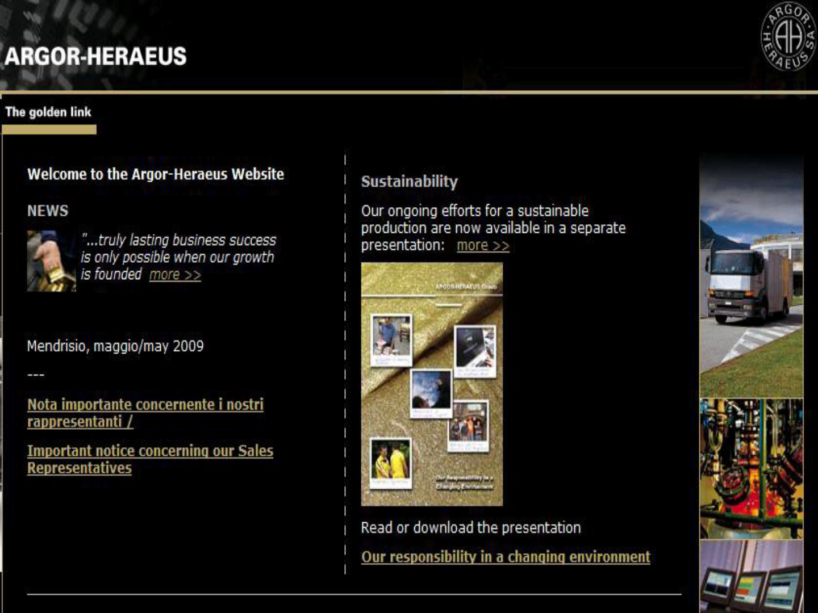

Slide 37
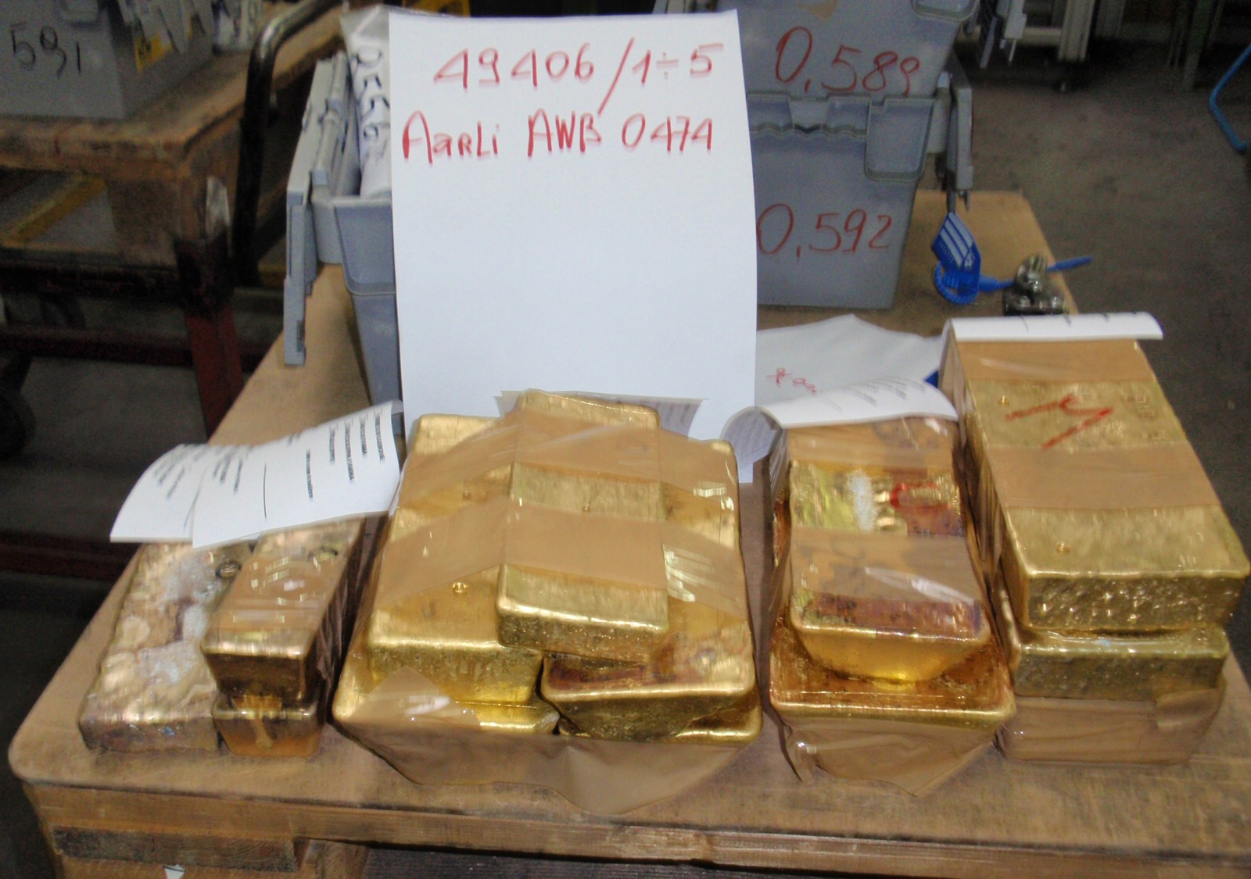

Slide 38

Slamlard s!iz,es ca.st bar.s
All bars ;ne individualty nu mbered (1excep whern o en!/ise req1Jested ) and delivere together with a cemtificate {on ly for 1000g, 500g and 250g ). See· alsc our minted bars or our worldwide exclusivity
kim eb¹ars.
For customized solutions contact: info@argor.com
1 | Wei:g1hl 1 00 g | Le1111·gt h mm 116.5 | Width mm 51.0 | Thickness 9.5 mm
2 | 5 0 g | 91.0 | 4 1.0 | 7.6 mm
3, | 250 g | 50.0 | 30.5 | 9.0 mm
4 | 1 0 g | 44.0 | 26.0 | 4.5 mm
5 | 10 olas | 44.0 | 26.0 | 5.5 mm

Slide 39



Swiss Platform Delivery Instructions for Physical Gold
DOCUMENTS:
Each shipment and delivery shall be identified with all assigned contract reference codes and numbers. Seller must provide the following documents to us, i.e. Via
Mat International AG (72-hours) prior to arrival of the Aircraft.
Three originals of Commercial Invoices, duly signed and issued by the Owner/Exporter in favour of GDIH Bullion Investment Ltd.
Packing List indicating Gross- and Net weight of each package, total of Pallets, Seal numbers etc.
Certificate Of Ownership, issued and duly signed by the Owner, confirming that the gold is free and clear and of non-criminal origin, unencumbered and free of any
liens, and is transferable and exportable

Slide 40



Certificate Of Origin, issued, stamped and duly signed by the respective authorities
Assay report issued, stamped and duly signed by the respective refinery, indicating Number and weight of each bar
Customs Declaration Form(s,) issued, stamped and duly signed by the respective authorities
Export Permit issued, stamped and duly signed by the respective authorities Original AWB (Airway bill) issued as mentioned below.
Shipping advice indicating Name of Airline, Flight number and date, arrival time at appropriate Airport.
Any other(s) relevant document(s) relating to the shipment of the goods (if applicable).
Remark: Insurance to be discussed with Via Mat International AG prior to shipment accordingly (if not arranged by the exporter already).
DELIVERY INSTRUCTIONS
Ex Warehouse – CIF to Airports in Europe or Middle East.

Slide 41


